Slide 1
Unit 4
12.4.25

Slide 2
DAS, SCADA………………

Slide 3
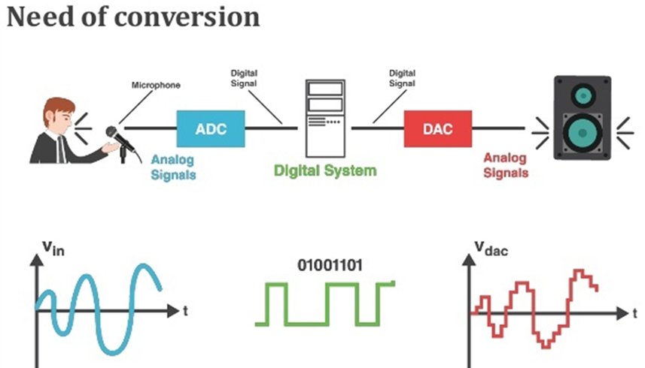
need of DAQ…..

Slide 4
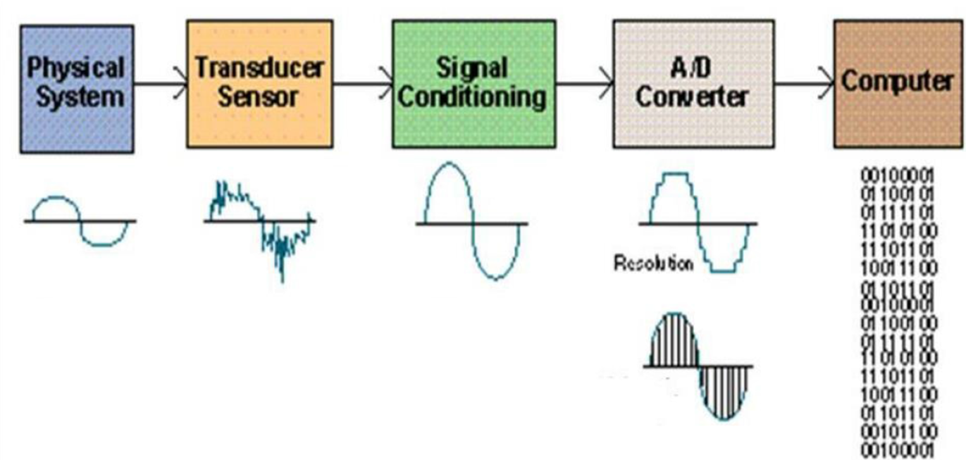
DAS
Physical variable :
Temperature
Pressure
Motion
Flow
Noisy Electrical signal
Filtered and amplified signal
Digitized signal
8 – bit
Binary code

Slide 5
Data Acquisition System (DAQ)
A data acquisition system is a collection of software and hardware that allows one to measure or control physical characteristics of something in the real world.
A complete DAQ consist of DAQ hardware, sensors and actuators, signal conditioning hardware, & a computer running DAQ software.

Slide 6
DAQ - Components
Sensors →used to collect data from the physical systems, [Sense physical variables.. speech signal, image signal, ECG signal, EEG signal and so on…)
Sensors that convert physical parameters to electrical signals. (TRANSDUCERS)…
Signal conditioning circuitry to convert sensor signals into a form that can be converted to digital values. (to make it readable by an A/D board)
Analog-to-digital converters, which convert conditioned sensor signals to digital values.

Slide 7
DAQ - Components

Slide 8
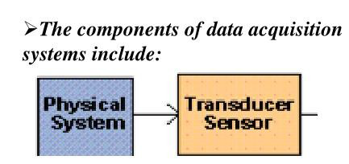
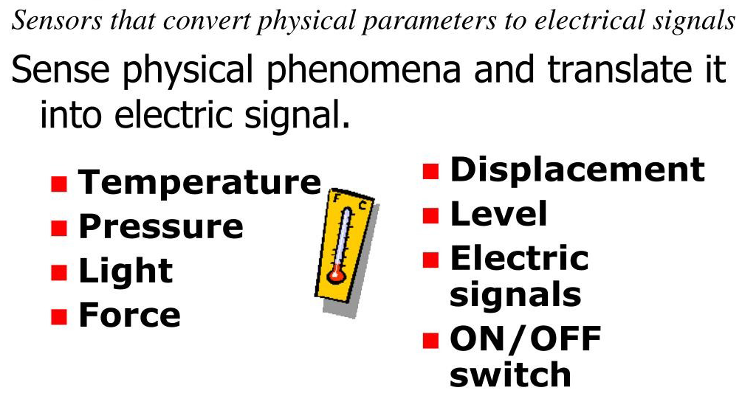
Sensors (Transducers)

Slide 9
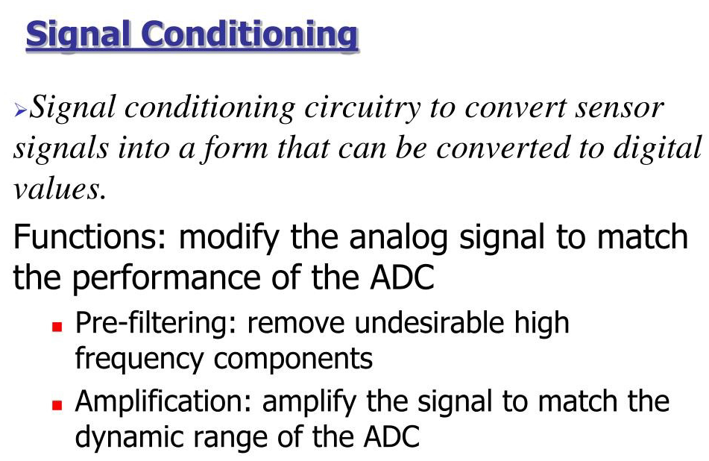

Slide 10
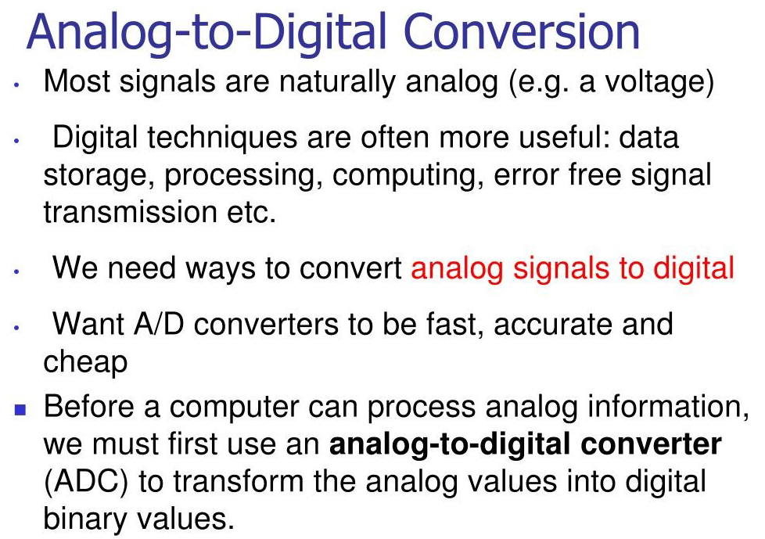

Slide 11
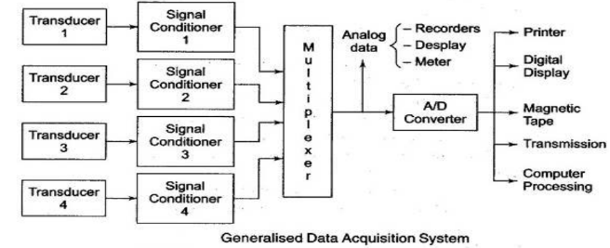
Generalized DATA ACQUISITION SYSTEM

Slide 12
SCADA
Supervisory Control and Data Acquisition

Slide 13
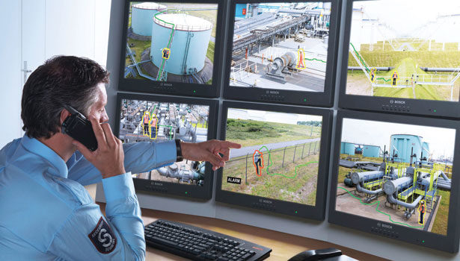

Slide 14
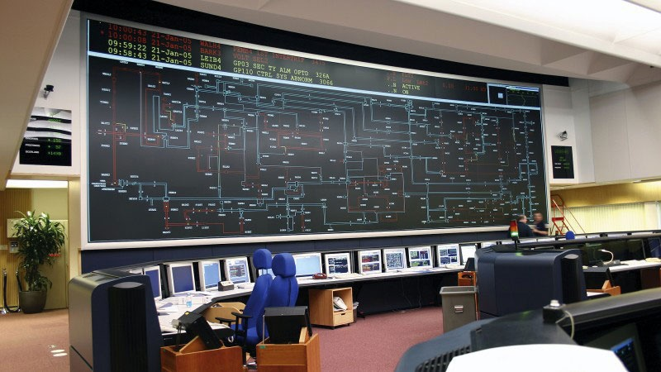
SCADA….

Slide 15
SCADA applications
Transportation Systems
Monitor and manage rail networks, traffic signals, and airport systems.
Building Automation
Security systems and lighting control.
Energy usage monitoring and optimization
Manufacturing & Industrial Automation
Monitor production lines, equipment status, and quality metrics.
Schedule maintenance and manage alarms.
Track real-time data for analytics and optimization
Oil & Gas, Power generation, water & waste water management & etc…

Slide 16
SCADA & DCS
SCADA system is a collection of both software and hardware components that allow supervision and control of plants ……………, both locally and remotely.

Slide 17
SCADA…...
SCADA system is used to gather and present data to operators, …….to make decisions about processes……. with the aid of operator input, and control plant functions based on those decisions.

Slide 18
SCADA …….. Includes
Sensors & Actuators – Collect data and control physical systems.
RTUs (Remote Terminal Units) – Connect to sensors and send data to central SCADA system.
PLCs (Programmable Logic Controllers) – Perform control logic locally.
HMI (Human-Machine Interface) – Visual display for operators.
Central SCADA Software – Processes and logs data, manages alarms, and enables control.

Slide 19
SCADA
SCADA system would be more popular where 3 or 4 sites need to connect to one main control room to visualize everything.
SCADA system can be geographically at different locations that's why there is a high distance communication required for SCADA
For instance, site ( A ) in a country, site (B) in another country and site (C) in another and communicate with each other, DCS system will never ever apply there. Definitely shall rely on the SCADA system.

Slide 20
SCADA
SCADA system is event driven.
In SCADA system if your communication failed by any reason SCADA system can still function.
SCADA system can also be implemented with the low cost and it's not a must requirement of redundancy in most of the SCADA system

Slide 21
SCADA….

Slide 22
SCADA in automation....
Supervisory control & data acquisition (SCADA) is a system of software and hardware elements that allows industrial organizations to:
Control industrial processes locally or at remote locations
Monitor, gather, and process real-time data…….
Directly interact with devices such as sensors, valves, pumps, motors, and more through human-machine interface (HMI) software
Record events into a log file…

Slide 23
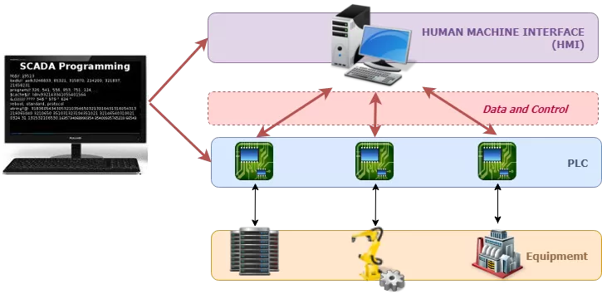
SCADA Diagram Example System with Main Components

Slide 24
How Do SCADA Systems Work?
Supervisory Control and Data Acquisition (SCADA) is a system that aims to monitor and control field devices at your remote sites.
SCADA systems are invaluable in industries where real-time monitoring and data acquisition are crucial.
These systems are critical as they help maintain efficiency by collecting and processing real-time data.

Slide 25
What it performs? (steps)
SCADA systems perform several functions that allow for proper management of remote facilities.
The following are the core functions of a SCADA system.
Four SCADA Functions……
DATA ACQUISITION..
NETWORK DATA COMMUNICATION
DATA PRESENTATION
CONTROL

Slide 26
Main Components Of SCADA
Inputs (either digital or analog) and output relays or electrical signals that directly interface with managed elements in the remote sites.
Remote Telemetry Units (RTUs) are just like PLCs. RTUs are small computerized units deployed in the field at specific sites and locations.
Human Machine Interface (HMI)- HMI software is a computer master station system that processes data and allows a human operator to manage and control the system.

Slide 27
SCADA in organisations..
Thus with SCADA, organizations can achieve:
Control: Manage processes locally or remotely.
Data Acquisition: Gather, analyze, and display real-time data.
Interaction: Directly engage with industrial equipment such as sensors, valves, pumps, and motors.
Event Recording: Document and archive events for reporting and future reference.

Slide 28
THANK YOU…….

